Slide 1
Server-Side!

Slide 2
A Moment of Caution

Slide 3

Focus!
Node + Express Servers and Routing are two of the
MOST IMPORTANT CONCEPTS
in the ENTIRE program.
Seriously… Try to learn this now.

Slide 4
Forewarning: This is the HARD Stuff
These next three weeks are some of the hardest to grasp.
But are also some of the most important.
This is where you go from humble HTML, CSS hackers to full-stack, employable engineers.
Bring your A-Game!!!
Don’t let this be you!

Slide 5
How to Succeed Through the Full-Stack Apocalypse
Form a Study Group Now Get in the habit of explaining in-class exercises to one another. Work together on homework assignments.
Take notes! Jot down concepts or key ideas that come out of activities. This class isn’t a lecture, but it may help you keep things straight!
Ask “Conceptual” Questions Don’t let big picture ideas gloss over you. Be courageous and ask questions in class. (Don’t worry -- if your question isn’t relevant, we’ll let you know. But if it is, you owe it to yourself to understand!)
Come to Office Hours As things get trickier, we’ll be available to review any concepts during office hours. Come to these. Ask questions! We want to help.

Slide 6
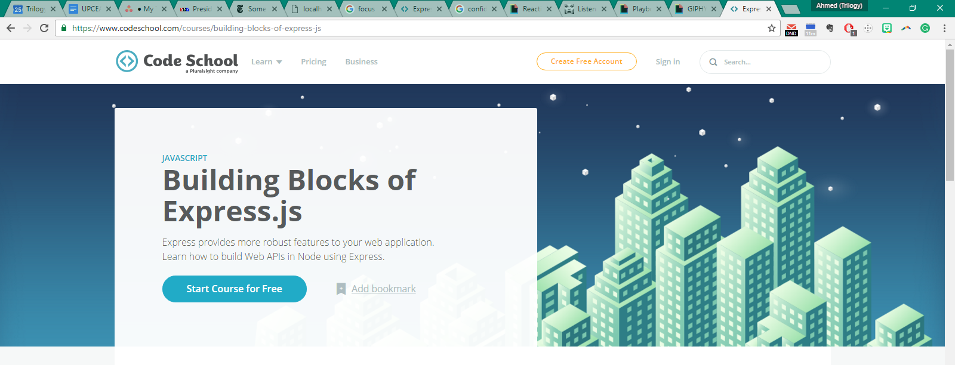
How to Succeed Through the Full-Stack Apocalypse
5. Get a Code School Trial Account Then immediately start completing the Building Blocks of Express.js course. It’s very good. https://www.codeschool.com/courses/building-blocks-of-express-js

Slide 7
How to Succeed Through the Full-Stack Apocalypse
6. Lastly, be confident !!!
There is zero reason to get despondent at this point. If you’ve made it this far, you’ve proven that you have what it takes to succeed. Keep going!

Slide 8
Remember Our Mantra…
When it comes to web development…

Slide 9
Remember Our Mantra…
I know nothing.

Slide 10
You.
Notes:
Seriously. Don’t lose sight of this image. At first it may feel intimidating. Knowing how little you know. But relish the opportunity and take the privileges it comes with.
You have permission to struggle. To fail. To not “get” everything immediately.

Slide 11
So Let’s Begin…

Slide 12
Remind me again…
What is a server?
In modern web applications there is a constant back-and-forth communication between the visuals displayed on the user’s browser (frontend) and the data and logic stored on the server (backend).

Slide 13
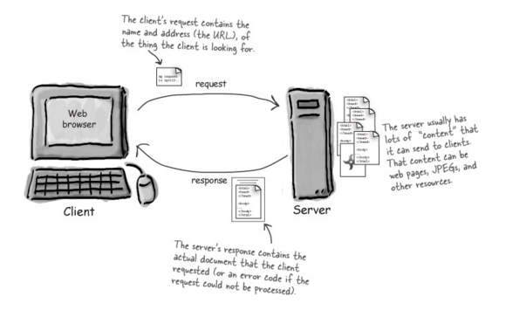
Server Definition
Server: The Machine and Code that handles requests and respond to them.

Slide 14
Remind me again…
What are examples of server-side functions?
In modern web applications there is a constant back-and-forth communication between the visuals displayed on the user’s browser (frontend) and the data and logic stored on the server (backend).

Slide 15
Server-Side Code in Action!
Visiting a URL and then being given an HTML page.
Visiting an API end-point that parse URL parameters to provide selective JSONs.
Clicking an invoice that provides a PDF report.
Image processing software that takes an image applies a filter, then saves the new version.
Google providing “results” relevant to your searches on other sites.

Slide 16
Server-Side Code in Action!
Visiting a URL and then being given an HTML page.
Visiting an API end-point that parse URL parameters to provide selective JSONs.
Clicking an invoice that provides a PDF report.
Image processing software that takes an image applies a filter, then saves the new version.
Google providing “results” relevant to your searches on other sites.

Slide 17
Remind me again…
What is a client?
In modern web applications there is a constant back-and-forth communication between the visuals displayed on the user’s browser (frontend) and the data and logic stored on the server (backend).

Slide 18
Client Definition
Client: The users’ personal machines that make “requests” of the server.

Slide 19
Bonus Question:
How do the client and server communicate with one another?
In modern web applications there is a constant back-and-forth communication between the visuals displayed on the user’s browser (frontend) and the data and logic stored on the server (backend).

Slide 20
HTTP Definition
Clients and Servers communicate back and forth using a series of understood communications defined by HTTP / HTTPs.

Slide 21
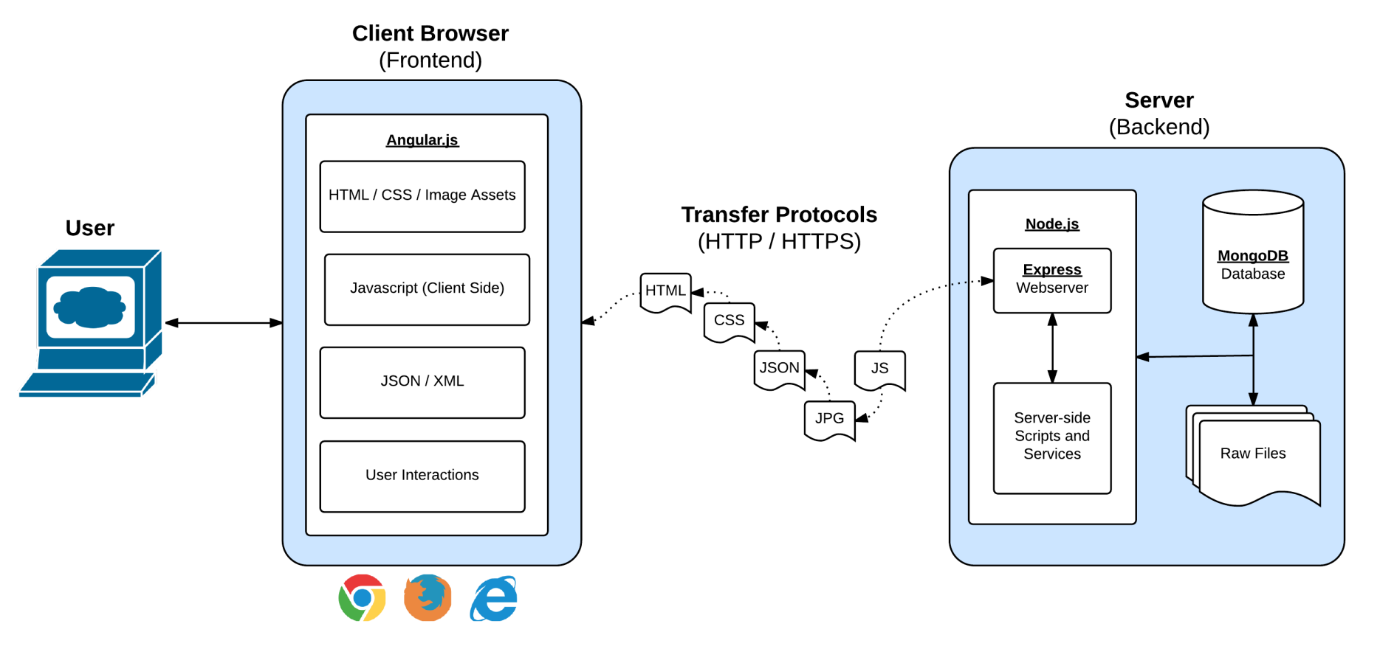
Full-Stack Development
In modern web applications there is a constant back-and-forth communication between the visuals displayed on the user’s browser (frontend) and the data and logic stored on the server (backend).

Slide 22
Full-Stack Development
In a way think of this as being two distinct machines.
A server is one machine and the client is a second machine.

Slide 23
Digging Deep into Server

Slide 24
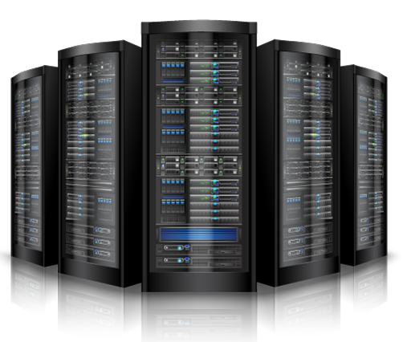
Visualizing Servers
Server Hardware look like large, ruggedized versions of desktop computers.

Slide 25

Visualizing Servers
These machines (and their respective code) handle all of the requests coming in from browsers accessing a website.

Slide 26
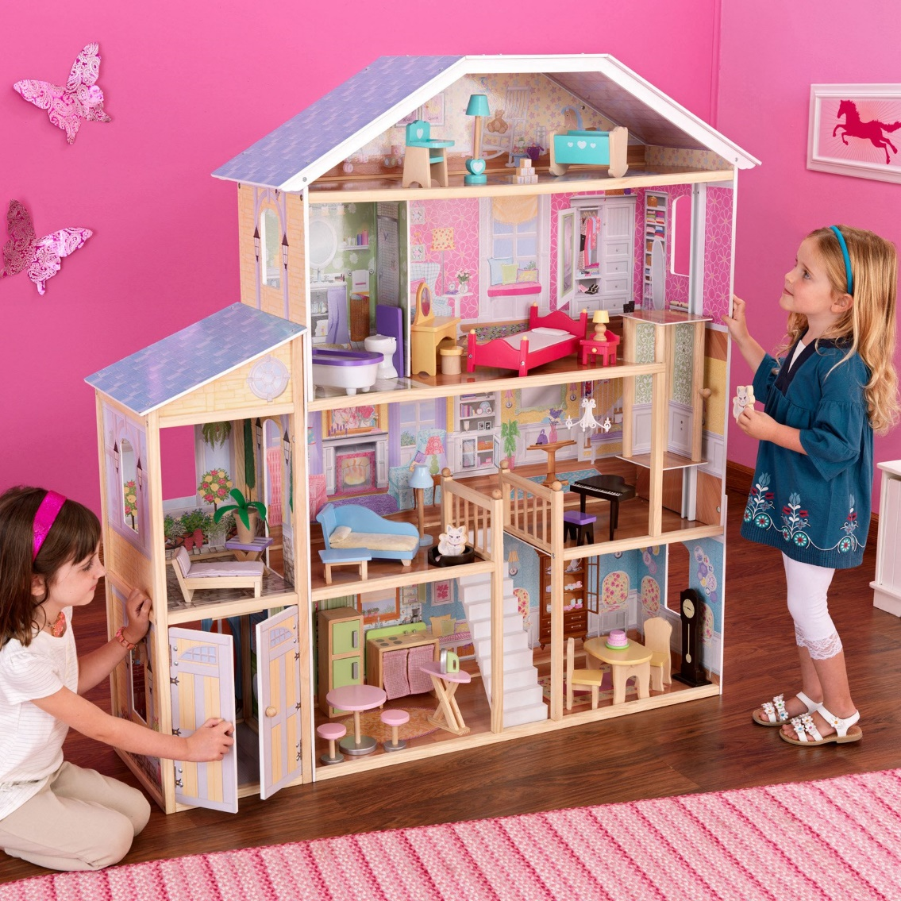
Visualizing Servers
Where does the server live?
In modern web applications there is a constant back-and-forth communication between the visuals displayed on the user’s browser (frontend) and the data and logic stored on the server (backend).

Slide 27



Where Do Servers Live?
Servers live in dedicated hardware intended to handle ALL the requests and responses of many clients.
Servers can live most often live on cloud platforms like AWS, Heroku, Google Cloud, etc.

Slide 28


Servers During Development
localhost
Important Note:
During development our personal computers will be able to simulate both.
We will create a “local server”
And then use our browser to interact with it.
browser

Slide 29
Building a “Server”

Slide 30
Creating a Server
For our purposes, “creating a server” equates to writing the code that handles what the server will do.
It’s important to note that even though you pay for server-side hardware, you still need to create the code that goes inside.
This code you create handles things like:
Connections to the database
Handling client-side URL requests
Performing server-side processes
Authenticating user requests
Logging client requests

Slide 31
A Big Box
Server
Throughout this week… imagine your server to be a big, empty box.
We will be adding code snippets and modules to give our big, empty box the powers to do stuff in response to all the requests that come in.

Slide 32
Inside the Box: Connections
Server
We’ll add listener such that the server can “begin” listening for requests.
Listen

Slide 33
Inside the Box: Parsing
Server
We’ll give our server the ability to “parse” URLs that the user requests.
Listen
URL Parse

Slide 34
Inside the Box: Routing
Server
Then based on the URL’s keywords, our server will be able to route (or direct the flow of logic to initiate other processes)
Listen
URL Parse
Route Handling

Slide 35
Inside the Box: Sending Files
Server
This subsequent process may be to send an HTML file to be rendered or to send a JSON file to be rendered…
Listen
URL Parse
Route Handling
Send HTML
Send JSON

Slide 36
Inside the Box: Receiving Posts
Server
We may also have a new module to handle receiving user’s POST requests (i.e. the data they send the server)
Listen
URL Parse
Route Handling
Send HTML
Send JSON
Receive POSTs

Slide 37
Inside the Box: Performing Logic
Server
We may also have complex server-side logic that we want to initiate in response to user’s visiting a route endpoint or sending us data.
Listen
URL Parse
Route Handling
Send HTML
Send JSON
Receive POSTs
Server Side Logic

Slide 38
Inside the Box: And More!
Server
But it doesn’t stop there!
We may add in functionality for authentication, logging requests, connecting to databases, and so much more.
But always remember… we’re coding out these functionalities into our box!
Listen
URL Parse
Route Handling
Send HTML
Send JSON
Receive POSTs
Server Side Logic
And More!

Slide 39
Questions?

Slide 40
Let’s Get Coding!

